Slide 1

Bayes classifiers and boosting
Machine Learning – Lab 3

Slide 2
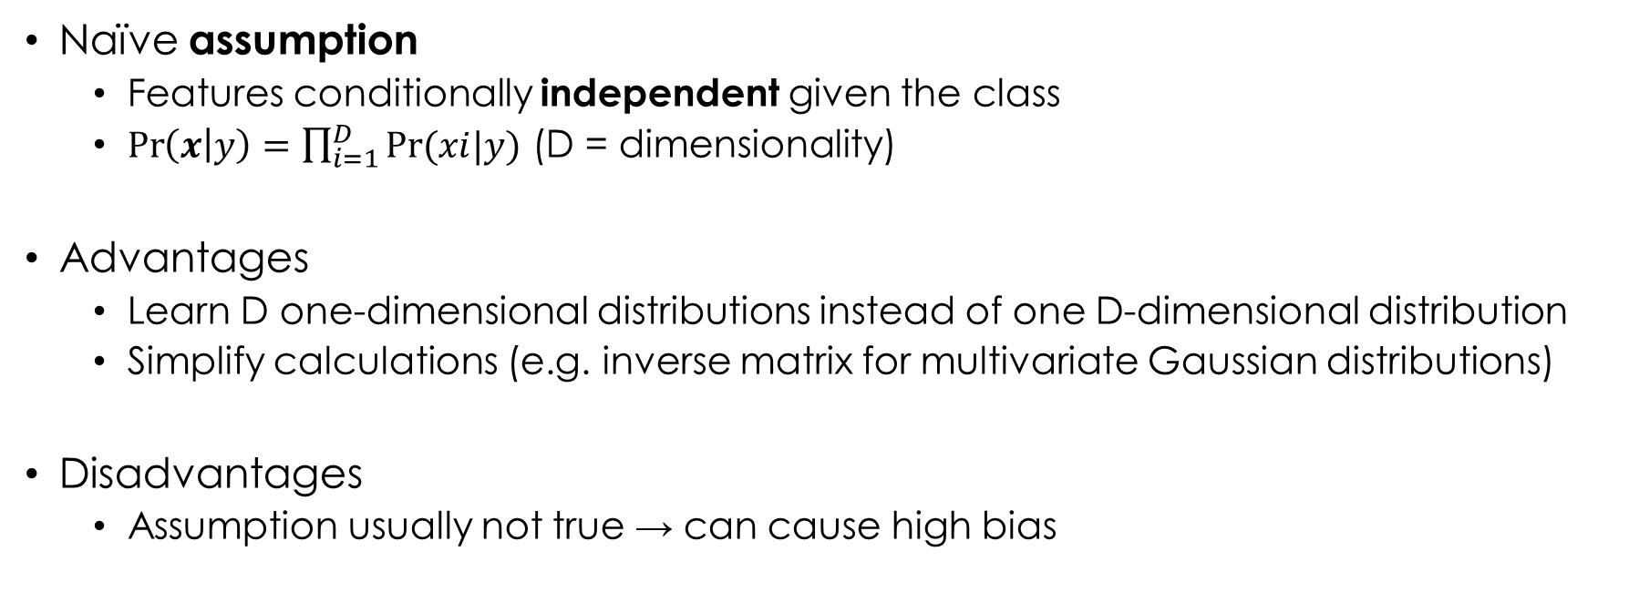
Naïve bayes classifier (I)
Naïve assumption
Features conditionally independent given the class
$\operatorname{Pr}\left(x | y\right)=\prod_{i=1}^{D}{Pr⁡(xi|y)}$ (D = dimensionality)
Advantages
Learn D one-dimensional distributions instead of one D-dimensional distribution
Simplify calculations (e.g. inverse matrix for multivariate Gaussian distributions)
Disadvantages
Assumption usually not true → can cause high bias

Slide 3
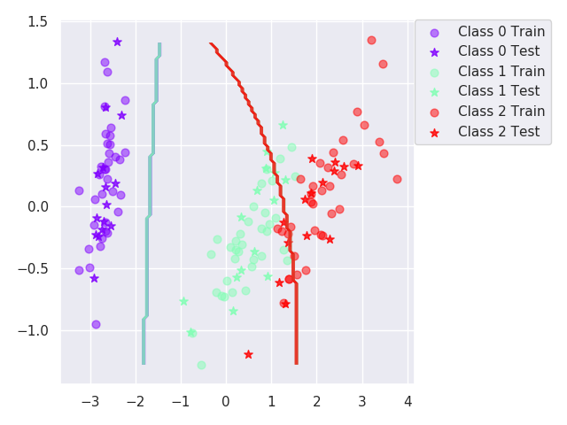
Naïve bayes classifier (II)
Iris dataset
2 correlated features
3 classes
Accuracy: µ = 89, σ = 4.16
Only 2 features and relatively simple decision boundary, but…
Not good decision boundary between class 1 and class 2

Slide 4
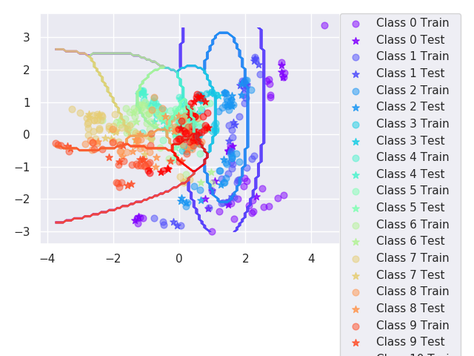
Naïve bayes classifier (III)
Vowel dataset
10 correlated features
11 classes
Accuracy: µ = 64.7, σ = 4.03
Much worse, more difficult

Slide 5
How to improve
Change classifier
SVM (extended for more than 2 classes, one-versus-one or one-versus-all)
Boosting

Slide 6
boosting (I)
Combine weak classifiers (high bias) in one strong classifier (low bias)
Naïve Bayes classifiers weak due to the unrealistic assumption
Our boosted Naïve Bayes classifier
Adaboost algorithm
10 Naïve Bayes classifiers (T=10)

Slide 7
Boosting (II)
Iris dataset
2 correlated features
3 classes
Accuracy: µ = 94.7, σ = 2.91
Without boosting: µ = 89, σ = 4.16
Improved
Vowel dataset
10 correlated features
11 classes
Accuracy: µ = 92.4, σ = 3.71
Without boosting: µ = 64.7, σ = 4.03
Improved dramatically

Slide 8

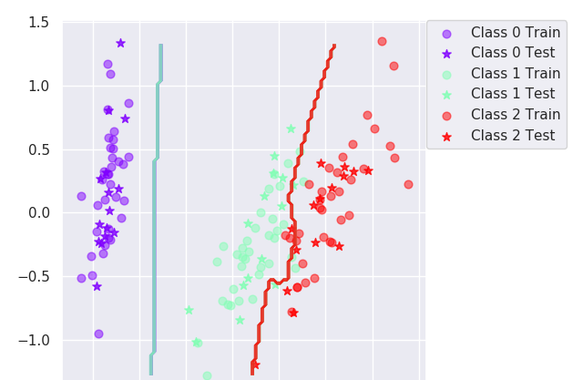
Boosting (III)
Iris dataset
2 correlated features
3 classes
Accuracy: µ = 92.4, σ = 3.71
Without boosting: µ = 64.7, σ = 4.03
More complex decision boundary, fits data better

Slide 9
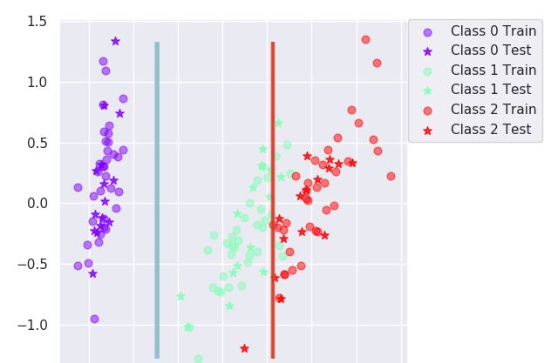
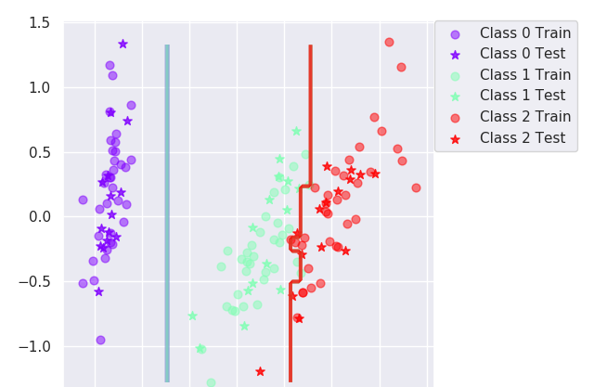
Decision trees (I)
Iris dataset
2 correlated features
3 classes
Accuracy
Without boosting: µ = 92.4, σ = 3.71
With boosting: µ = 94.6, σ = 3.65

Slide 10
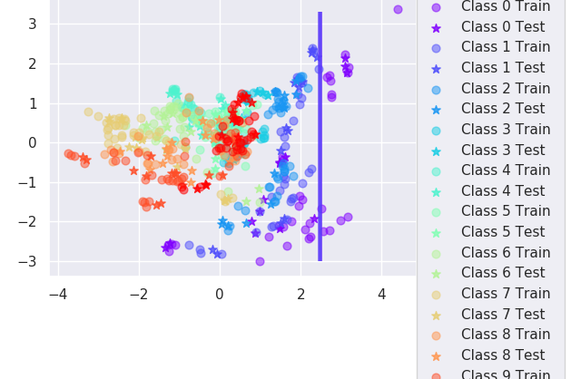
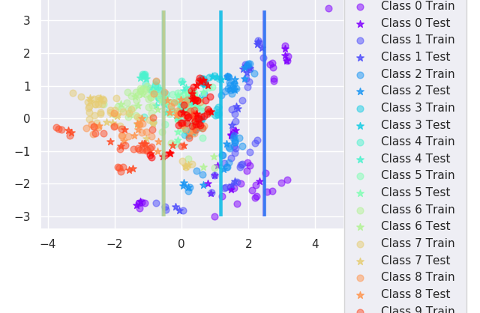
Decision trees (II)
Vowel dataset
10 correlated features
11 classes
Accuracy
Without boosting: µ = 64.1, σ = 4
With boosting: µ = 86.9, σ = 3.07
The plots are 2D but actually the dataset has 10 features, so decision boundaries are not visualized well.

Slide 11
Naïve bayes vs Decision tree
Outliers
Naïve Bayes is robust (based on probabilities)
DT is robust (nodes are determined based on purity indexes of partitions, not single points)
NO boosting (weights corresponding to outliers increase and outliers become more important)
Irrelevant features
Naïve Bayes does not ignore them (probabilities of all features are always computed)
DT can ignore them when pruning (no node uses them)
Predictive power
Naïve Bayes has more expressiveness than DT (DT has decision boundaries parallel to axes)
Boosting increases expressiveness
Mixed types of data
Naïve Bayes is more expressive for continuous attributes than DT
Boosting increases accuracy
Scalability
DT is much faster than Naïve Bayes (Naïve Bayes has to compute probabilities)
Boosting can be time consuming depending on T

